Slide 1

COMPUTER Fundamentals
SESSION: 2020-23
Submitted by : Anshuman Sharma
Roll no : 05 (Science)
Submitted to : Rajeev Sir

Slide 2

Why we need computers in our daily life?
The computer plays a vital role in our daily life. We use a computer regularly for various purposes. In today's digital world, it is a necessity to have and use a computer in daily life to live.
When the first computers were developed, they were used only in the field of mathematics and science and mostly military. Today, computers are widely used in fields such as engineering, health care, banking and education. Computers have made our lives a lot easier. Not only do they compile algorithms for us that usually take a few hours, but they also help us with tasks like CAD and photo editing that would have been more complicated.

Slide 3

3
Computer invention was a very big change in the world. Each and everything is now based on computer expect nature.
Let us see how computers are being used effectively in our day to day life for performing important tasks……

Slide 4



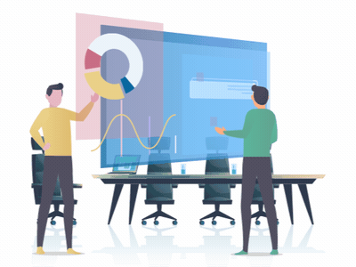
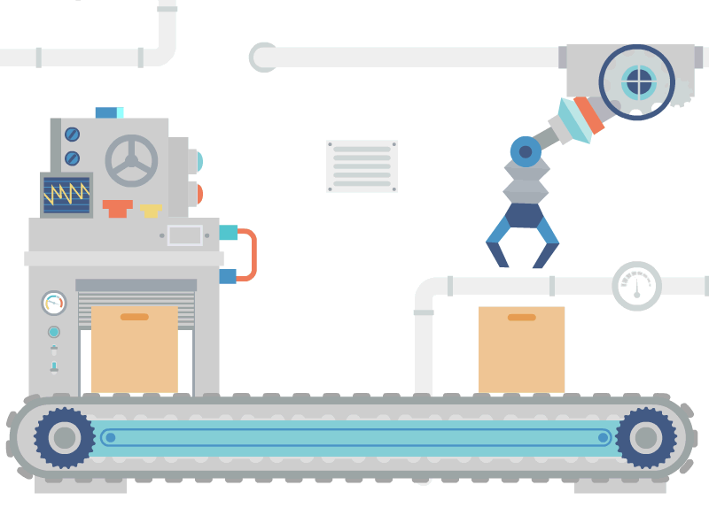

Fields using Computers
EDUCATION
HEALTH
BUSINESS/OFFICES
ENGENEERING&INDUSTRY
ANIMATION & MULTIMEDIA

Slide 5
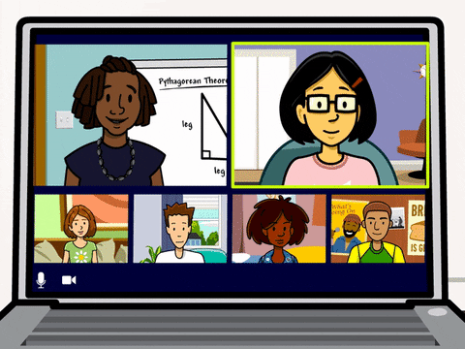
EDUCATION
A computer is a powerful teaching aid and can act as another teacher in the classroom. Schools and colleges around the world are using computer technology to teach students digitally and creatively through information visualization.
Teacher may use pictures, graphs and graphical presentations to easily illustrate otherwise difficult concept. Moreover, they can use computers to administer assignments and keep track of grades.

Slide 6

Health
The use of computers in hospitals provides many benefits for doctors and patients.
Storing records: Computers are first and foremost used to store the medical records of patients. Hospitals can create a database of a patient with their treatment records, medication records.
Surgical procedures: Computers enable surgeons to use computers to control and move surgical instruments in patient’s body for a variety of surgical procedures.
Better diagnosis: Doctors are using computers to quickly diagnose patients.

Slide 7

Bussiness/offices
Businesses and companies use computer for marketing and business plans, recording customer information. Using computers, they manage their services and products. Almost all kinds of businesses are using computers in their daily official tasks.
Computers boost the productivity of any official work. They let employees finish off their job at a faster rate and with improved accuracy and efficiency. There are many applications that speed up the official work process and standards.

Slide 8
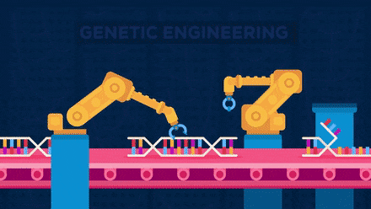
INDUSTRY & ENGENEERING
Computers are found in all kinds of industries, such as thermal power plants, oil refineries, and chemical industries, for process control, computer-aided designing (CAD) and computer-aided manufacturing (CAM).
Computerized process control is used to enhance efficiency in applications such as production of various chemical products, paper manufacturing, etc.
Computers are used in the engineering field for design, modeling, analysis and communication. They’re also used in robotics and similar fields.

Slide 9
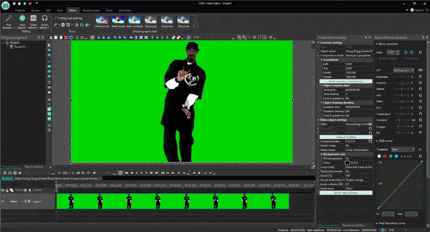
MULTIMEDIA & ANIMATION
One of the most powerful aspects of computing technology is multimedia and animation which combines still images, moving images, text and sound in meaningful ways.
Animation is an easy and effective way to show complex interactions or events. Thus, it is an excellent tool for educating an audience. Multimedia is used to prepare training courses.
Multimedia and animation is used to create computer games. It is also used to add special effects in movies. A laser show is also an example of multimedia application.

Slide 10
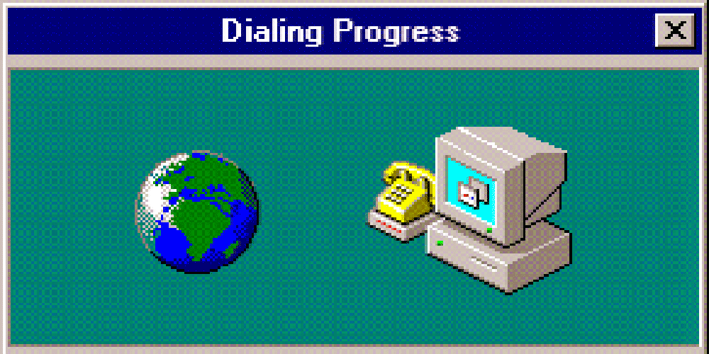
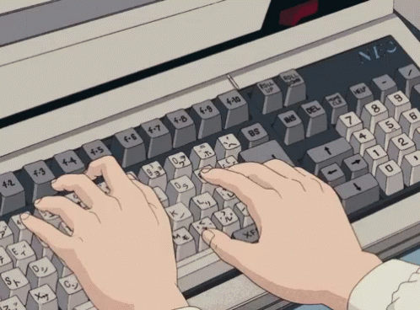
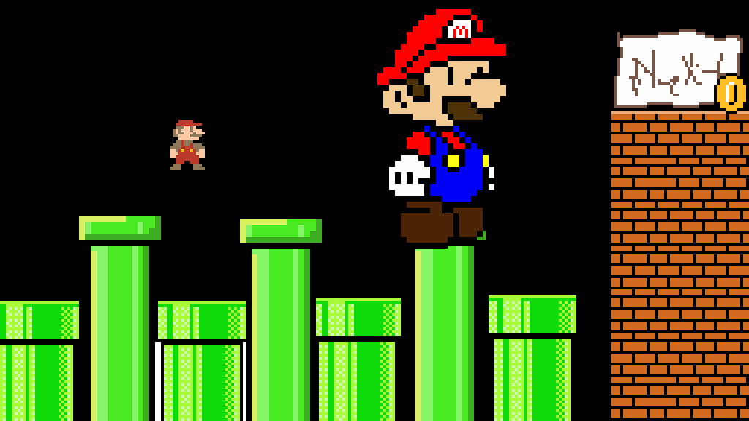

Many other day to day uses
Access to information
Typing and Editing
Gaming and entertainment
Bookings and reservations

Slide 11

Thank You!
Computers are magnificent tool for the realization of our dreams, but no machine can replace the human spark of spirit, compassion, love and understanding.

